Slide 1




NEXT GEN EMPLOYABILITY PROGRAM
Creating a future-ready workforce
Team Members
College Name
Student Name : Prem Kumar B
Student ID :au951221104032
JP College Of Engineering

Slide 2

CAPSTONE PROJECT SHOWCASE
Project Title
Voting Web Application using Django Framework
Abstract | Problem Statement | Project Overview | Proposed Solution | Technology Used | Modelling & Results | Conclusion

Slide 3
Abstract
Developed on Django, our voting web app simplifies democratic engagement. Users easily register, browse polls, and cast votes securely. Django's robust framework ensures scalability and data integrity, maintaining user privacy. With intuitive UI/UX design, navigating the platform is effortless, enhancing user experience. Real-time updates and result displays foster transparency, promoting trust in the electoral process. Empowering civic participation, our app revolutionizes digital democracy.
Source :

Slide 4
Problem Statement
Current voting systems lack accessibility and user-friendliness, deterring participation.
Concerns regarding the integrity and security of online voting platforms persist.
Absence of real-time updates and transparency undermines trust in electoral outcomes.
Limited scalability and adaptability of existing solutions hinder widespread adoption and effectiveness.
Source :

Slide 5
Project Overview
The project aims to develop a secure and user-friendly platform for conducting online voting and surveys, utilizing the Django framework.
Key features include user authentication, intuitive interfaces for administrators and participants, real-time result updates, and data visualization.
The project leverages Django's robust features for backend development, HTML/CSS/JavaScript for frontend design, and possibly additional libraries or frameworks for enhanced functionality.
Upon completion, the project will deliver a scalable and reliable voting solution, prioritizing security, usability, and accessibility, suitable for various use cases such as elections, opinion polls, or feedback collection
Source :

Slide 6
Proposed Solution
.
Develop a user-centric voting web application leveraging Django framework for robustness and scalability.
Implement encryption and secure authentication protocols to ensure the integrity and privacy of voter data.
Integrate real-time result tracking and transparent reporting mechanisms to enhance trust and accountability.
Employ responsive design principles for cross-device compatibility, promoting widespread accessibility and engagement.
Source :

Slide 7
Advantages
Increased Participation: Accessibility from any internet-connected device facilitates broader engagement in the voting process.
Efficient Development: Leveraging Django framework expedites development cycles, optimizing resource utilization.
Robust Security: Integration of encryption and authentication protocols ensures the protection of voter data, mitigating risks of tampering or intrusion.
Trustworthy Governance: Real-time result tracking and transparent reporting cultivate trust in electoral procedures, bolstering confidence in democratic practices.
Source :

Slide 8
Disadvantages
Potential for Technical Glitches: Complexities in web application development may lead to bugs or system failures, disrupting voting processes and eroding user trust.
Vulnerabilities to Cyber Attacks: Despite security measures, online platforms remain susceptible to hacking or data breaches, compromising the integrity and confidentiality of voter information.
Digital Exclusion: Dependence on internet access excludes individuals without reliable connectivity or technological literacy, perpetuating disparities in democratic participation.
Legal and Regulatory Challenges: Compliance with diverse legal frameworks and electoral regulations poses logistical hurdles and may delay or impede the implementation of the voting web application.
Source :

Slide 9
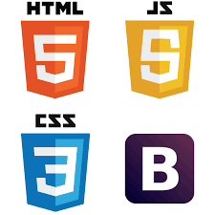


Technology Used
Frontend
Backend
Source :

Slide 10
Modelling & Results
Data Modelling: Employ Django's ORM to structure data efficiently, optimizing storage and retrieval of user, poll, and voting data.
Algorithm Implementation: Develop algorithms for vote processing and result calculation, ensuring accuracy and responsiveness in displaying real-time outcomes.
Validation and Testing: Conduct thorough testing to validate model functionality and algorithm accuracy, addressing any discrepancies or errors to maintain data integrity.
Continuous Monitoring: Deploy monitoring tools to track system performance and user interactions, facilitating ongoing analysis for improvements and optimizations.
Source :

Slide 11
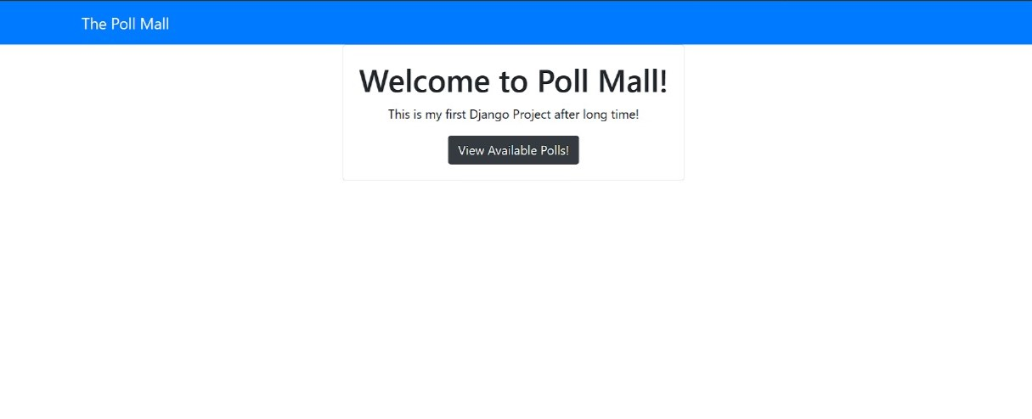
Homepage

Slide 12
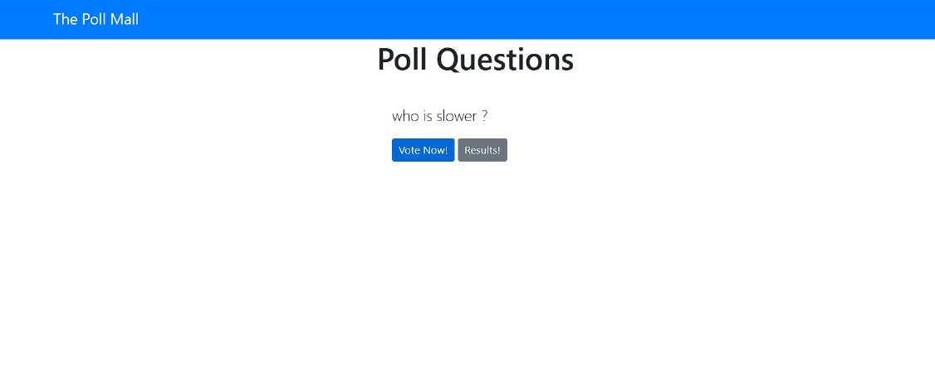
Polling questions page

Slide 13
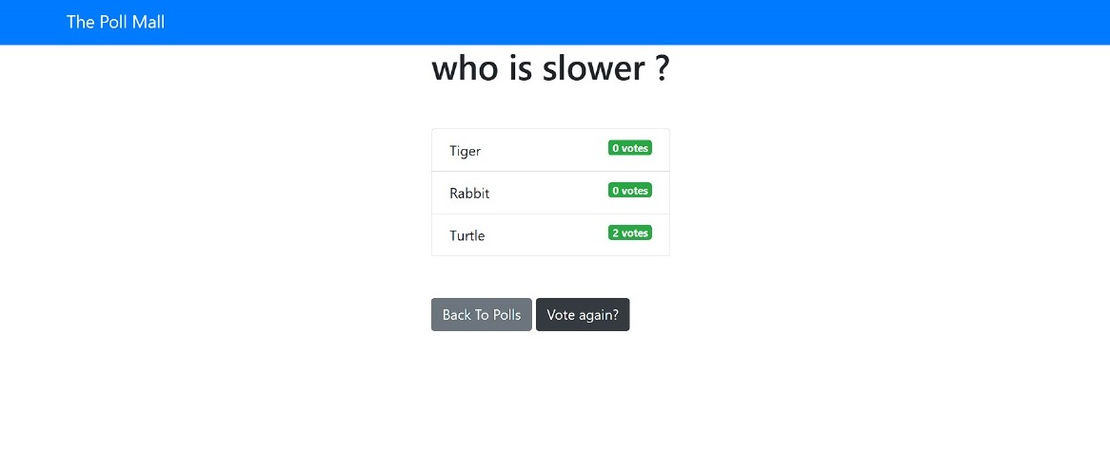
Voting page

Slide 14
Future Enhancements:
Integration of Blockchain: Explore incorporating blockchain technology for enhanced security and transparency in the voting process.
AI-Powered Personalization: Implement AI algorithms to tailor user experiences, offering personalized recommendations and notifications.
Mobile Application Development: Expand accessibility by developing dedicated mobile applications for seamless voting on smartphones and tablets.
Gamification Elements: Introduce gamification features to incentivize participation and foster community engagement in the voting platform.

Slide 15
Conclusion
In conclusion, the development of a voting web application using the Django framework presents a promising avenue for modernizing electoral processes. By prioritizing accessibility, security, and transparency, we aim to empower citizens to actively participate in democratic decision-making. While challenges such as technical complexities and regulatory compliance must be navigated, the potential benefits of increased engagement and trust in governance are substantial. Continued refinement through testing, monitoring, and iterative improvements will be essential to ensure the effectiveness and reliability of the platform. Ultimately, by embracing innovation and leveraging technology responsibly, we can advance the democratic ideals of inclusivity, accountability, and civic empowerment in the digital age.
Source :

Slide 16
Thank You!
Notes:
Thank You !!

